Slide 1
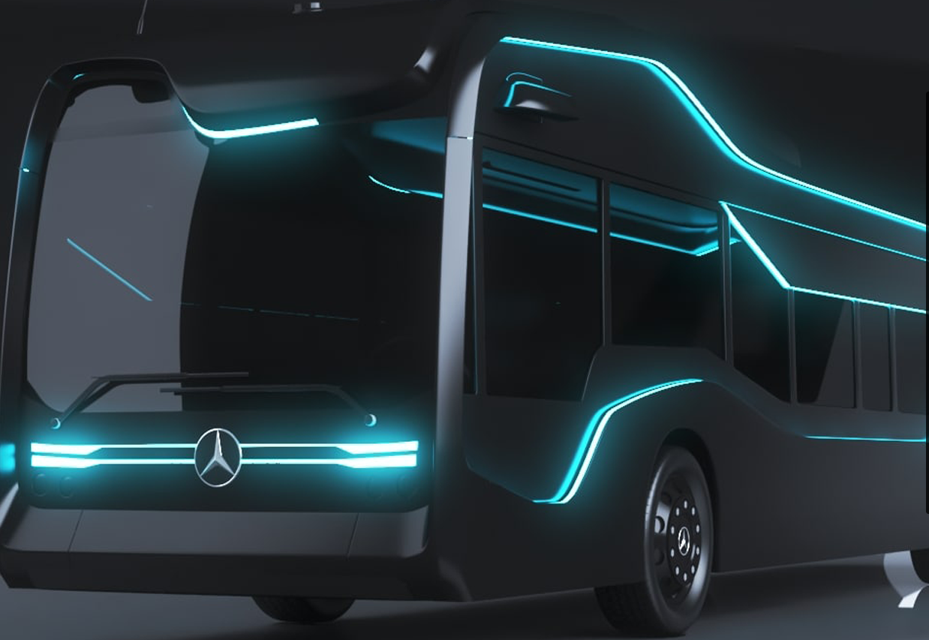
PLA Search –User Manual
October 2020
Version 1.0

Slide 2
PLA Single Recall Application Overview
Introduction
System walkthrough

Slide 3

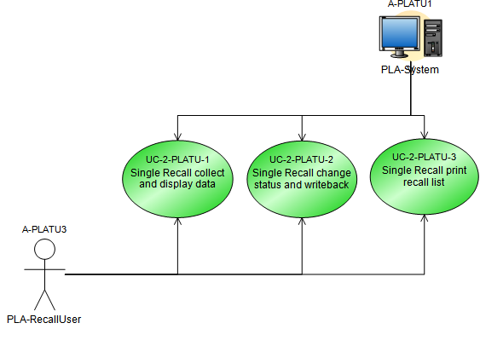
Introduction
The single recall is used for the selective change of a parts recall status without the need to use the standard recall application

Slide 4
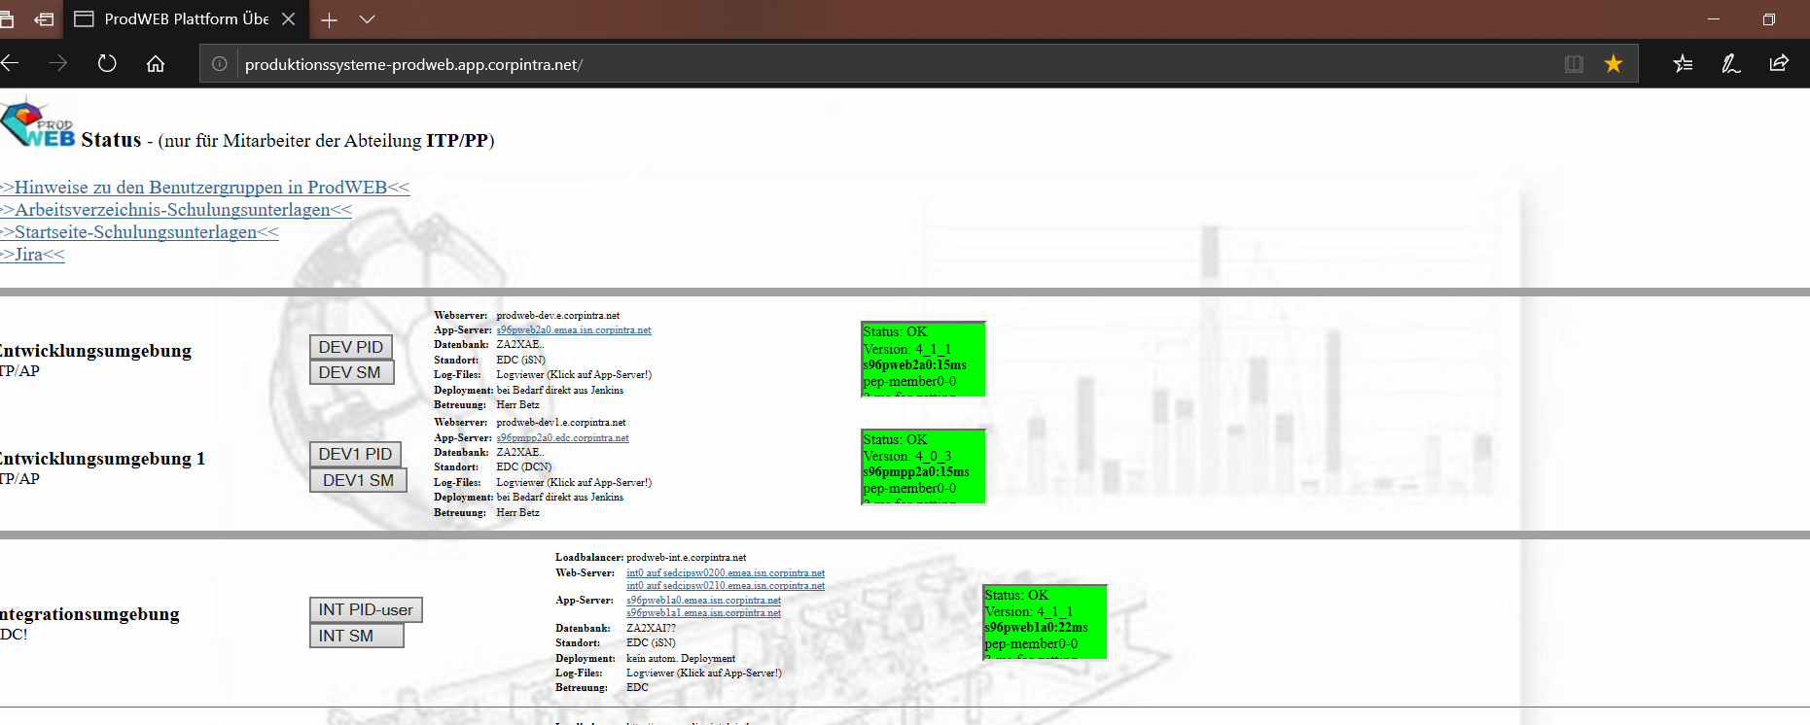
Initiation
Navigate to http://produktionssysteme-prodweb.app.corpintra.net/.
Click on Dev1 SM and Enter your credentials
Click on DEV1 SM

Slide 5
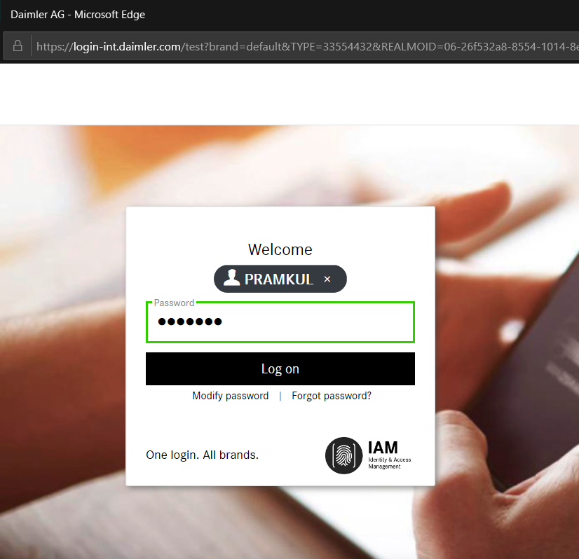
Initiation
Enter valid user name and password and Click on Log on button
Enter the Login credentials
Click on Log on

Slide 6
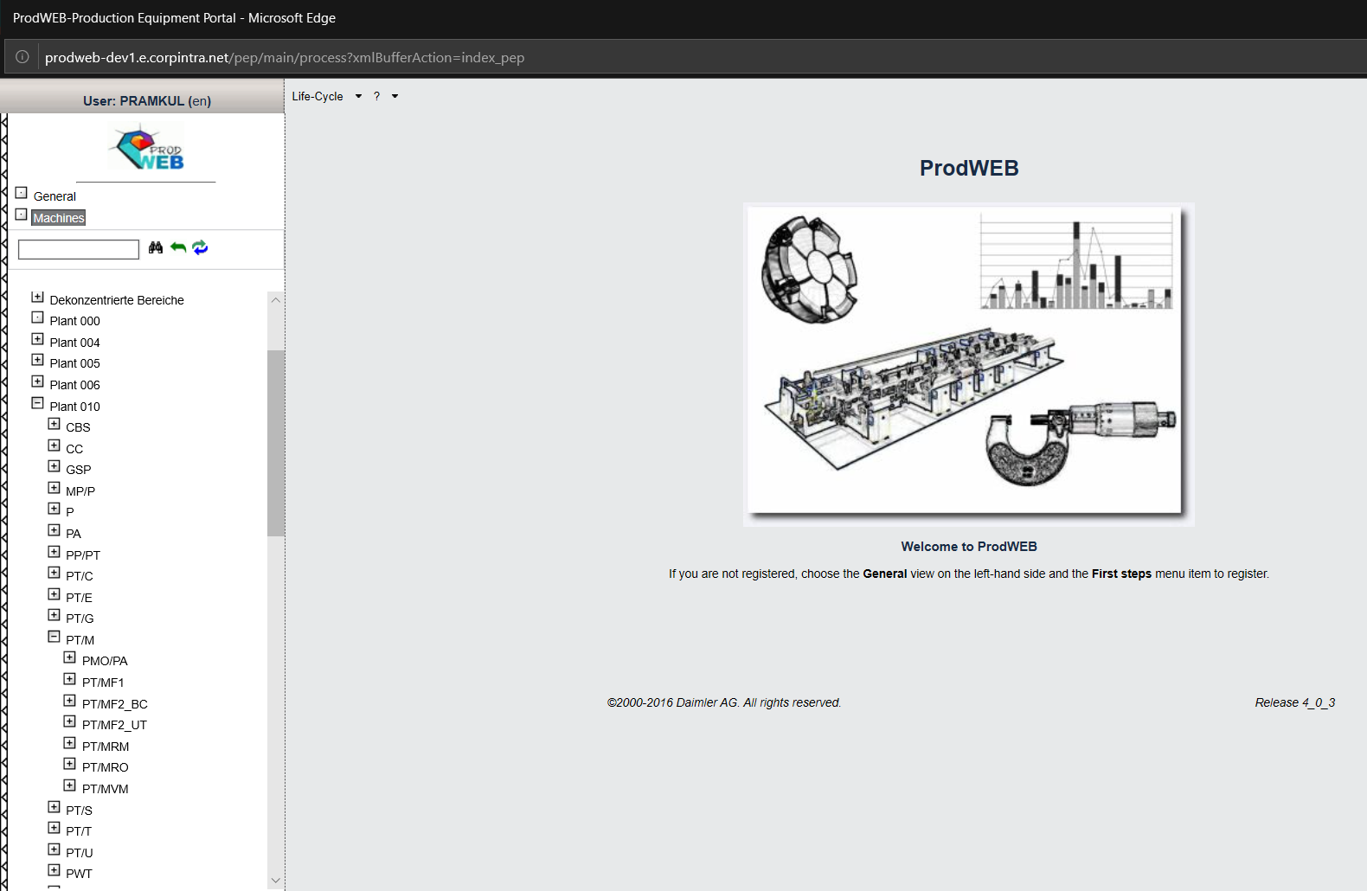
Home Page-Prod web tree
On Click of login button Prodweb page is displayed.
PLA user can select respective Plants and Cost center and access the PLA application
Plant 10 points to Plant Untertürkheim
To select particular node navigate from Machines->Plant 10 →Production Engines[PT/M] → PT/MVM
PT/M Consists of Production Engine information
All Engine Component Manufacturing information is present in node PT/MF2_UT

Slide 7
Content
System Tutorial

Slide 8
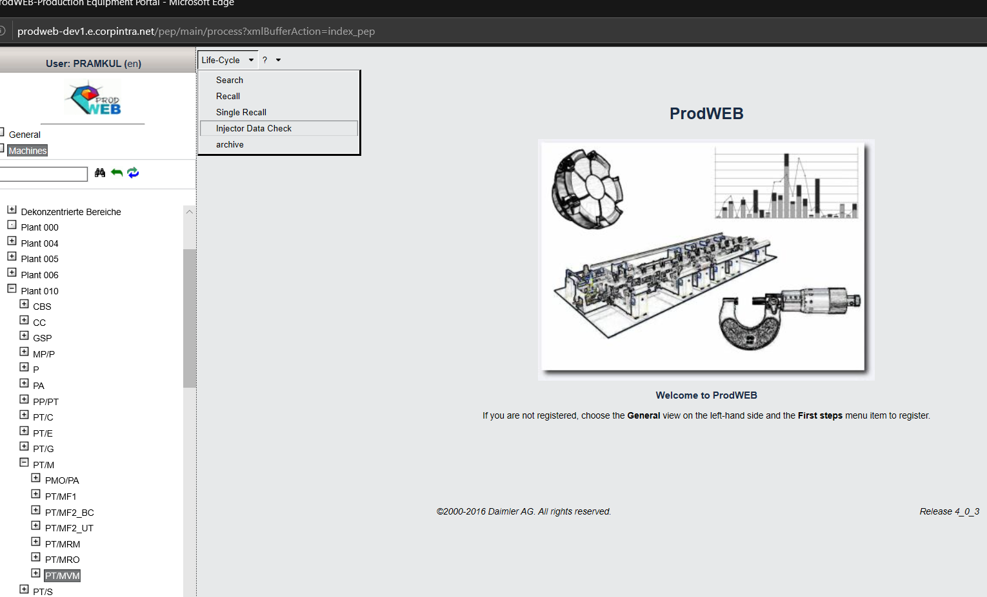
System Tutorial Navigation
PLA-User can access any module based on the rights assigned to each user. On Click of Single Recall module Single Recall Search page will be displayed
Life Cycle Menu bar Consists of 5 modules. Search, Recall, Single Recall, Injector data check and archive
MBRDI is only responsible for Search, Recall, Single recall and Injector Data check. Archive is not in the scope of MBRDI.

Slide 9
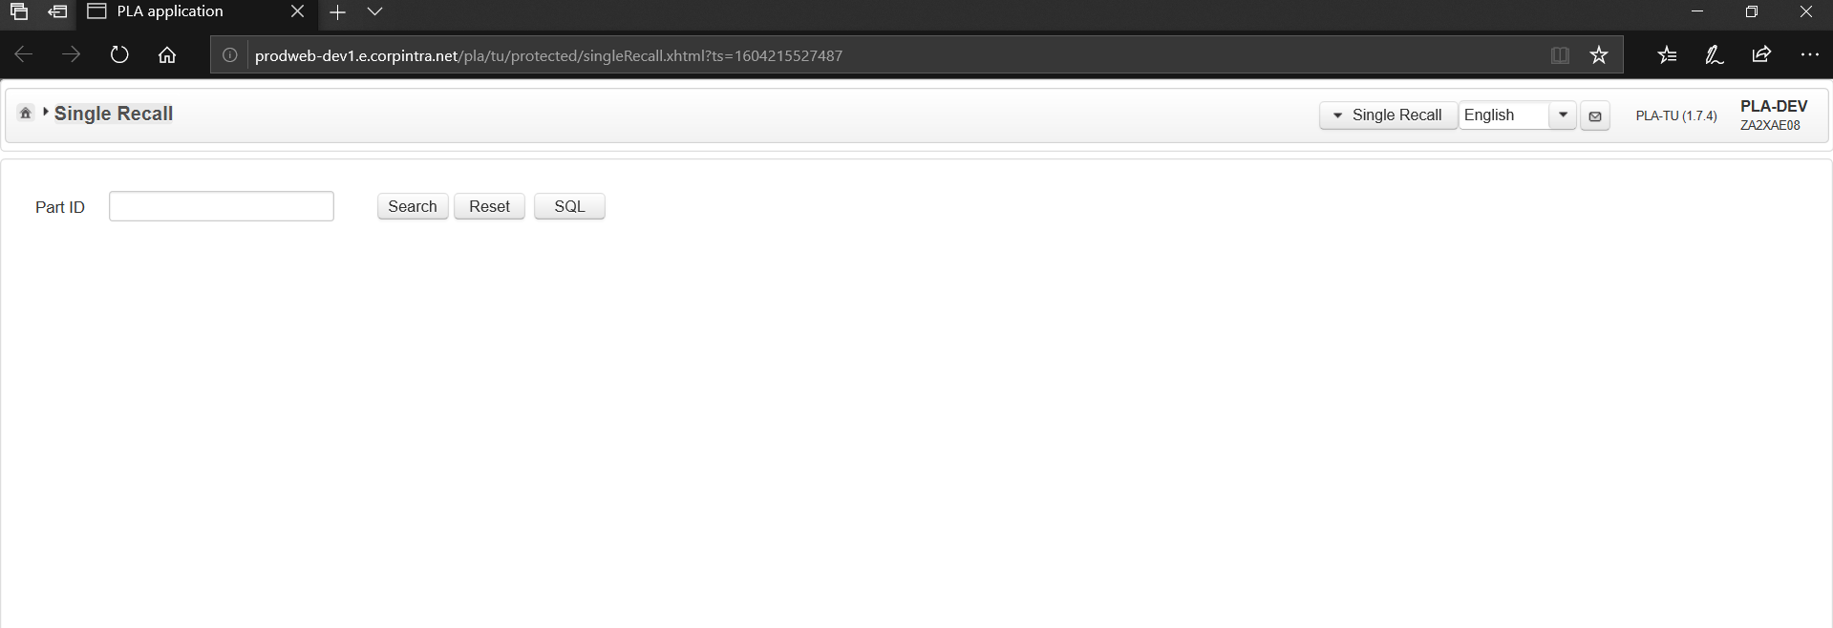
Single Recall Screen
Single Recall Page consists of part ID input field to perform search. PLA-RecallUser enters a part ID in the only input field on the screen.
Single Recall Page consists Search, Recall and SQL button
Module Switcher to navigate from Single recall to other modules.
PLA Recall user has option to change language from English to German and Vice Versa

Slide 10
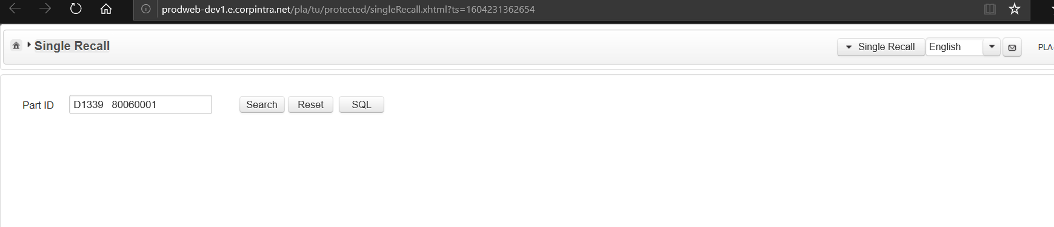
Single recall on Click of Search
Input part ID”D1339 80060001” input field and Click on Search button. Search result is checked and displayed to PLA recall user by PLA system.

Slide 11
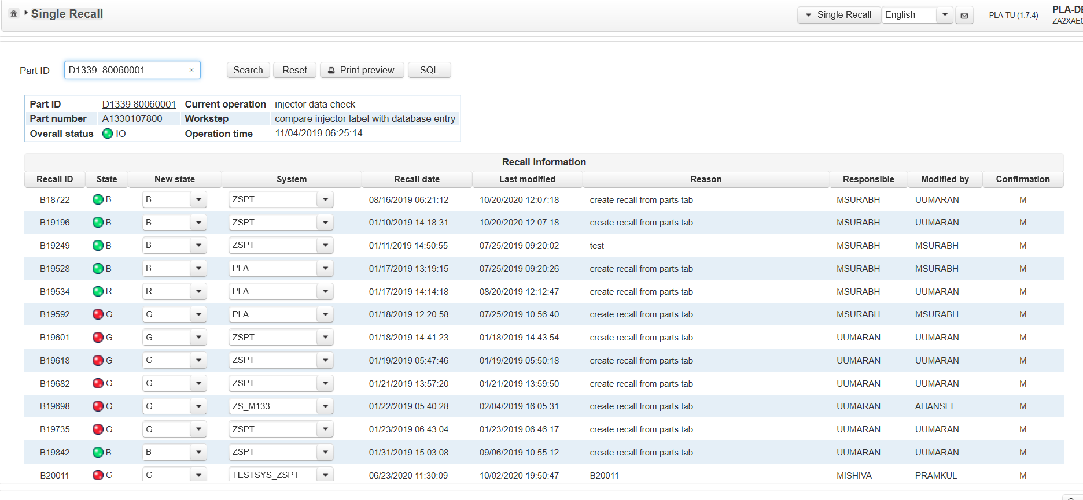
Single recall on Click of Search
.
Part Overview table with fields are part ID, part number, current operation, part number, work step , overall status and operation time. All the part information is fetched from the DB.
Part id should act as a hyperlink. On Click of hyperlink Part tree lifecycle window should be displayed .

Slide 12
Single recall on Click of Search button
.
Each column must contain the expected data.EG:Recall id must contain recall id only.
State column must contain red and green icons
Recall numbers are sorted alphabetically
Recall information table with columns as recall_Id, state, new state, system, recall data, last modified, reason responsible, Modified by and confirmation

Slide 13
Single recall on Click of Search button
.
Click on part ID hyperlink

Slide 14
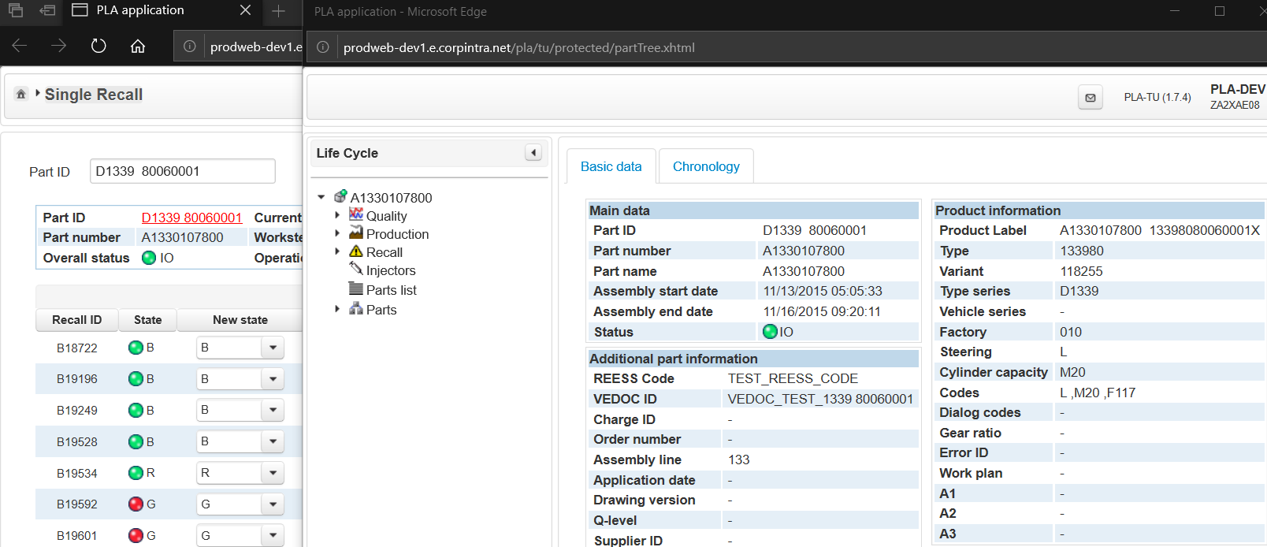
On Click of Part ID hyperlink
.
Life Cycle window should be opened in Separate window. Complete Life cycle information of part can be seen here.

Slide 15
Click of Print preview button
.
Click on Print preview button

Slide 16
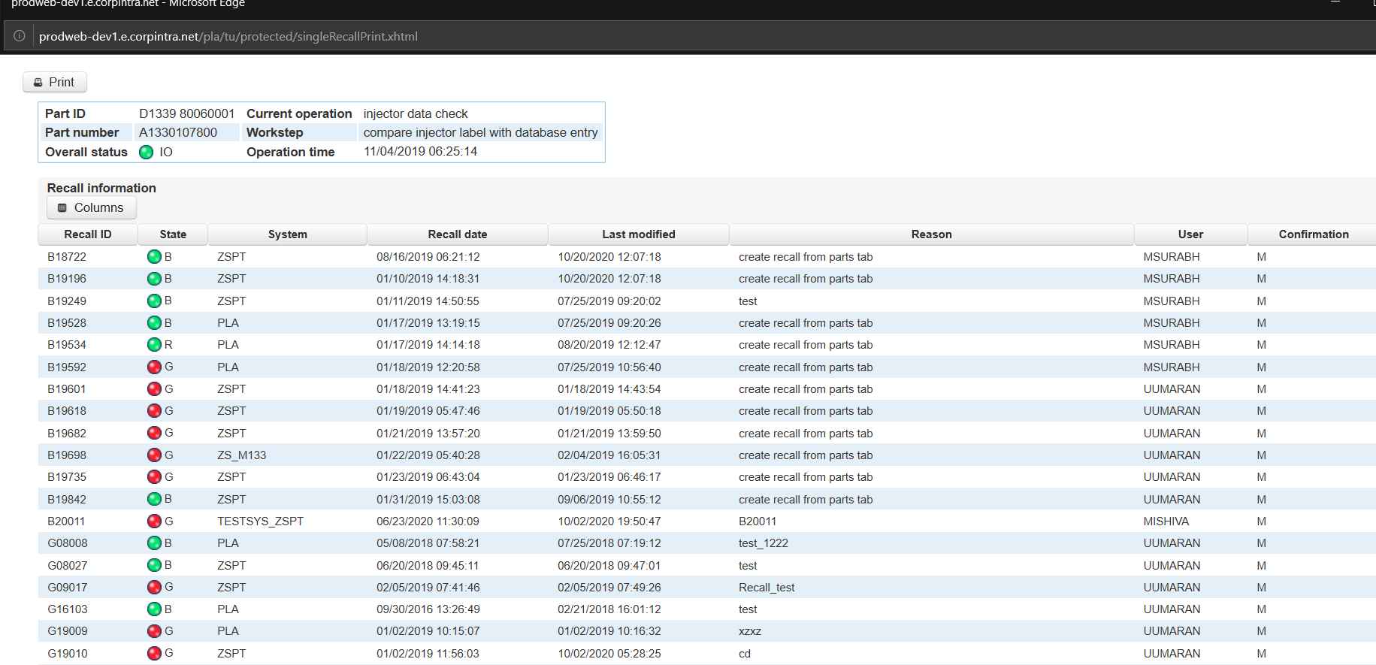
Click of Print preview button
This is print button. On Click of Print button, Print options should be displayed .
.
Print preview window is opened separate window and complete single recall information should be printable.
This consists of columns toggle to remove columns which shouldn’t be part of print. Column toggle consists of checkbox, boxes which are checked only those columns will be printed

Slide 17
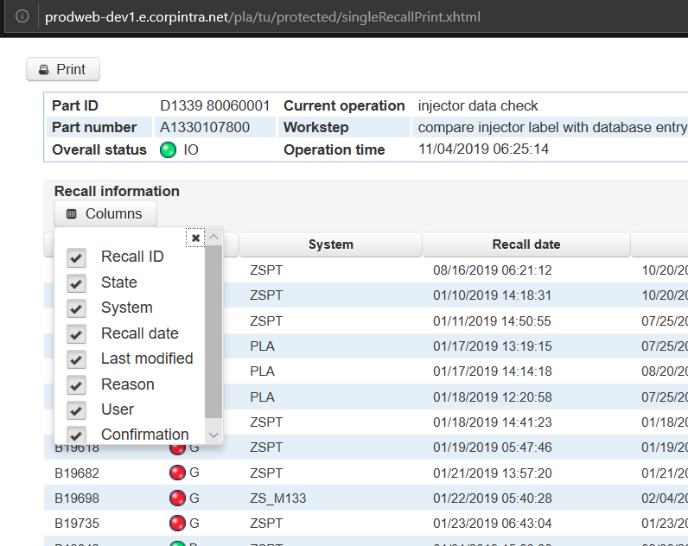
On Click of Column toggle
This is print button. On Click of Print button, Print options should be displayed .
.
This consists of columns toggler to remove columns which shouldn’t be part of print. Column toggle consists of checkboxes, boxes which are checked only those columns will be printed

Slide 18
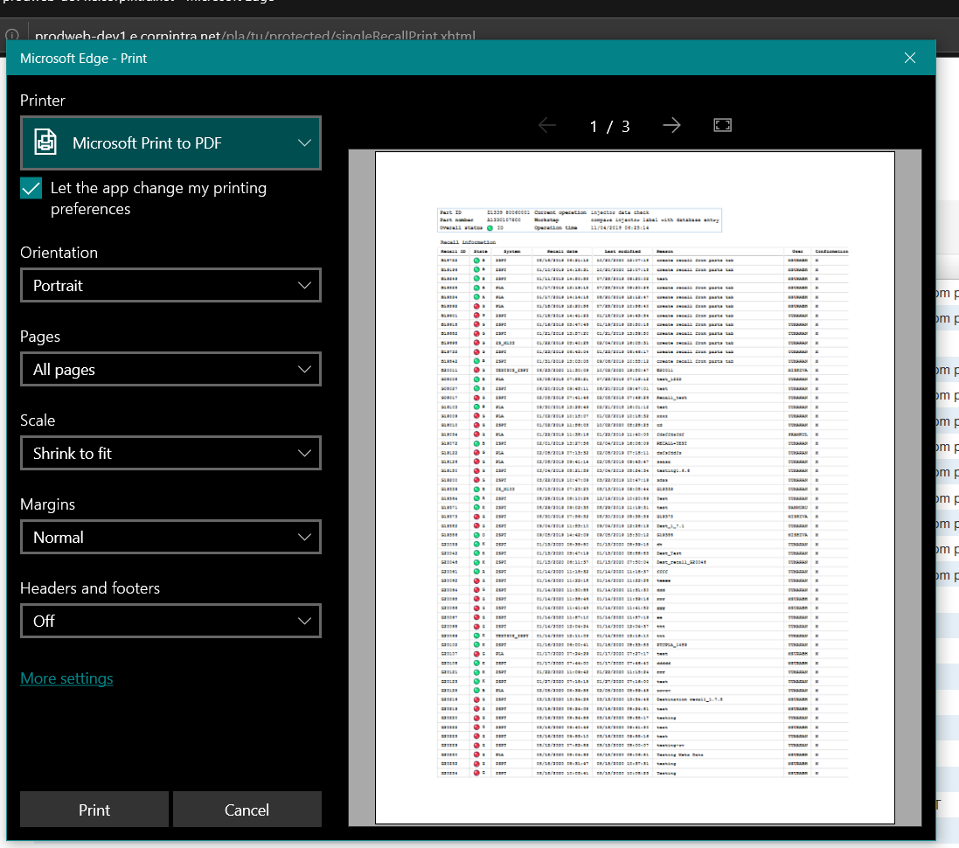
On Click of Print button inside print preview window
.

Slide 19
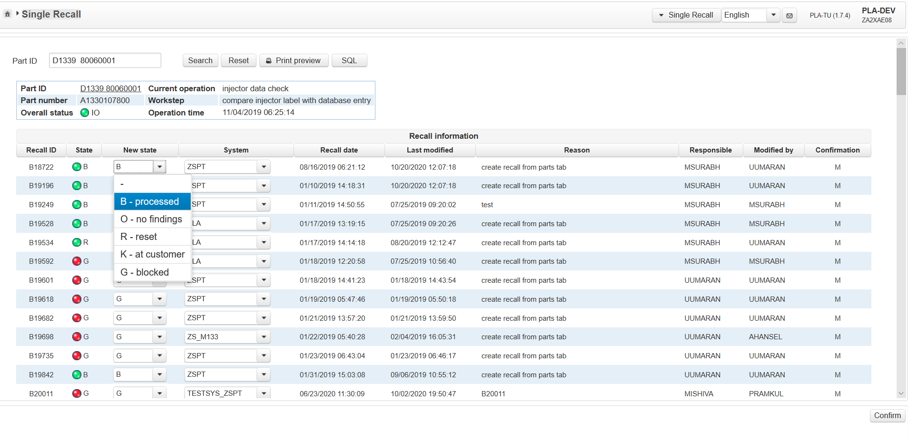
Change status and system for recall number B18722
.
Click on Confirm button
Change Status from B to G

Slide 20
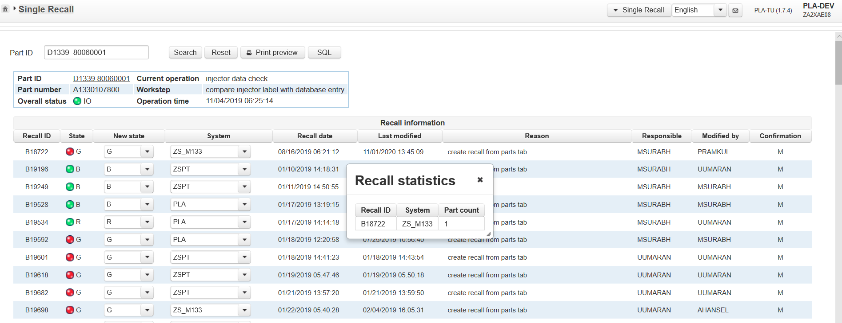
On Click of Confirm button
.
Last modified should be updated with current timestamp
Modified should be updated with current logged in user name
Status is changed to G from B for recall number B18722
Status is changed to G from B for recall number B18722
System is changed to ZS_M133 from ZSPT
Recall statistics should be displayed with recall ID, System and Part count

Slide 21
Click on Reset button
.
Click on Reset button

Slide 22
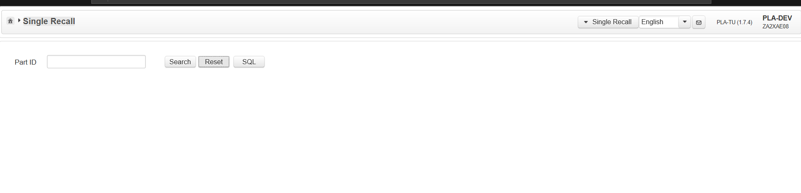
On Click of Reset button
.
On Click of Reset button ,Results are cleared.

Slide 23
Single Recall Confirmation
When Status and System is changed and clicked on confirm button, Status and System should be updated for that recall number and stored in DB. Recall Statistics should be displayed with count value.
When Life cycle window is opened after Status and System change , Information should get updated in respective recall number. Expand accoridian to view the state, modified date and user.Entry should get created in chronology arranged based on date (Ascending order)“.
Print preview must reflect the updated data of recall number. Part Overview and "Recall Information " to be displayed with same data . Data should match.

